Slide 1
CONVERTING COLOUR IMAGE TO BINARY EQUIVALENT IMAGE
PROJECT
STUDENT NAME : PADALA SAI BAP REDDY
DEPARTMENT:CSE[AIML]
SUBJECT:DIGITAL IMAGE PROCESSING

Slide 2
CONTENT
Problem Statement
Technology used
Wow factor
End users
Result
Conclusion
Git-hub Link
Future scope

Slide 3
PROBLEM STATEMENT
The project focuses on converting a color image into its binary equivalent using efficient image processing techniques. It involves reducing the color spectrum of an image to grayscale, followed by applying suitable thresholding methods like global, adaptive, or Otsu's thresholding. The solution should support various image formats such as JPEG, PNG, and BMP, ensuring scalability and clarity in output. It aims to retain critical features while minimizing noise or data loss during the conversion process. The system must handle edge cases like low-contrast or noisy images effectively. A user-friendly interface will allow users to adjust parameters and visualize results in real time. Comprehensive documentation and tutorials will guide users in understanding and utilizing the solution efficiently. The project targets applications like object detection, document analysis, and medical imaging. Future scope includes exploring machine learning for adaptive thresholding and enabling real-time processing. Ethical use and considerations will be emphasized throughout the development process.

Slide 4
TECHNOLOGY USED
Python is the best-suited programming language. It offers a rich ecosystem of libraries like OpenCV, Pillow, and NumPy for image processing and manipulation. Python's simplicity, flexibility, and extensive community support make it ideal for developing efficient and scalable solutions for tasks like color-to-binary image conversion.
Libraries:
OpenCV: For image processing tasks, including thresholding and grayscale conversion.
Pillow (PIL): For image manipulation and format handling.
NumPy: For numerical operations and efficient array handling during image processing.
Scikit-image: For advanced image processing techniques and thresholding methods.
Matplotlib: To visualize the results of image processing.
TensorFlow/Keras/PyTorch (Optional): For integrating machine learning models for adaptive thresholding.
Platforms:
Python: As the main programming language due to its rich ecosystem of libraries.
Jupyter Notebook: For interactive development and visualization of results.
VS Code: A versatile IDE for writing and debugging your code.
GitHub: To manage version control and collaborate on code.
Google Colab: For cloud-based development, especially when working with large datasets.

Slide 5
WOW FACTORS
This project stands out for its blend of simplicity, adaptability, and innovation in solving a fundamental image processing challenge. Unlike typical solutions, it not only converts color images to binary equivalents but also introduces multiple thresholding methods, enabling users to optimize results for diverse image types. The inclusion of advanced options like adaptive and Otsu’s thresholding showcases technological sophistication, while offering user-friendly features like real-time visualization and customizable parameters ensures accessibility. It tackles edge cases like noisy or low-contrast images with precision, making it reliable across various scenarios. The project’s scalability for batch processing and potential integration with machine learning for adaptive thresholding adds futuristic value. By supporting multiple image formats and providing thorough documentation, it ensures smooth usability. The application scope ranges from object detection to medical imaging and document analysis, demonstrating practical versatility. Ethical considerations and future enhancements, such as real-time processing, position it as a forward-thinking solution for impactful technological advancements. This project’s balance of technical excellence, user focus, and societal relevance truly sets it apart.

Slide 6
END USERS
Researchers and Scientists: For tasks like pattern recognition, object detection, and machine learning model training.
Medical Professionals: To process medical images such as X-rays and CT scans for analysis or diagnosis.
Document Analysis Experts: For converting scanned documents into binary images for Optical Character Recognition (OCR) systems.
Graphic Designers: To preprocess images for various creative or artistic purposes.
Educational Institutions: For teaching and exploring image processing concepts in academic courses.
Surveillance and Security Teams: To enhance visual data for monitoring and analysis.
Software Developers: For integrating this functionality into broader systems or applications.
Industrial Engineers: For quality inspection systems in manufacturing using binary image analysis.

Slide 7
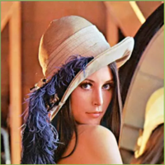
INPUT

Slide 8
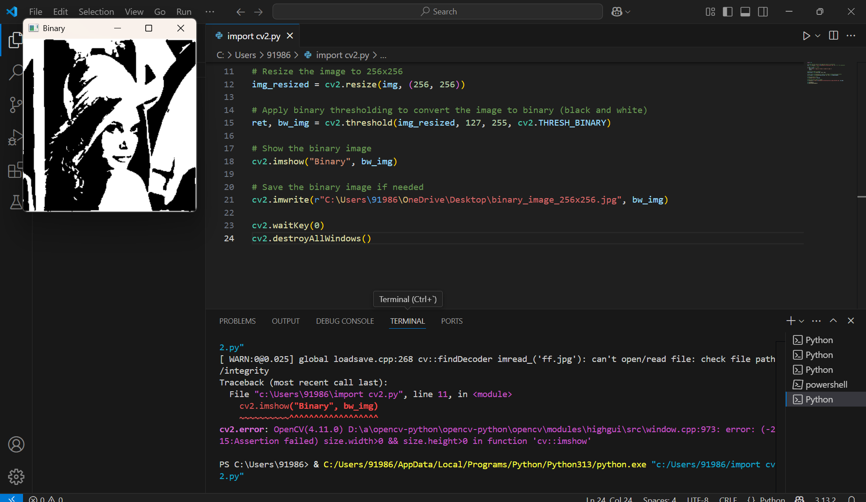
PROGRAM

Slide 9
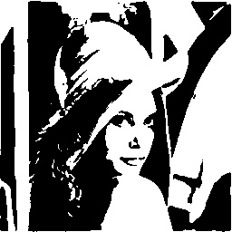
OUTPUT

Slide 10
CONCLUSION
In conclusion, this project provides an efficient and versatile solution for converting color images into binary equivalents. By integrating advanced thresholding techniques and ensuring adaptability across various image formats, it addresses diverse applications such as medical imaging, document analysis, and object detection. Its user-friendly design, scalability, and focus on clarity make it accessible to both experts and novices. With potential for future enhancements, such as real-time processing and machine learning integration, the project holds significant value in advancing image processing technologies. Through comprehensive documentation and ethical implementation, it ensures practical usability while maintaining responsible usage. Overall, this project is a valuable contribution to the field of digital imaging and its real-world applications.

Slide 11
GITHUB LINK
https://github.com/saibapireddypadala/CHANGING-COLOUR-IMAGE-INTO-BINARY-IMAGE.git

Slide 12
FUTURE SCOPE
Machine Learning Integration: Automate threshold selection for better accuracy using AI models.
Real-Time Processing: Enable instant image conversion for live applications like video analysis.
Edge Detection: Incorporate edge detection algorithms for feature extraction and object recognition.
Batch Processing: Scale the system for efficient bulk image conversion.
Cloud-Based Deployment: Offer cloud-based solutions for remote processing and access.
Mobile Application: Develop a mobile app for on-the-go image conversion.
Advanced Thresholding: Explore hybrid methods for handling complex images.
Tool Integration: Embed the system into devices like scanners or medical imaging tools.
New Applications: Adapt for use in fields like agriculture or astronomy.
Ethical AI: Ensure responsible use, especially in sensitive areas like healthcare and surveillance.

Slide 13
THANK YOU

